Slide 1

Ortho Eyes
Tim bekema
Beau fiechter
Donna van grunsven
Jasmijn Heupers
Emma korf
Danny vink

Slide 2
Table of contents
Recap
What did we do?
What will we do next?
Questions

Slide 3
Recap
Animated the movements from different angles
The research question
Which models can be added to the OR-ensemble to improve the classification of individuals to the correct patient group using the existing data from a Flock of Birds system?

Slide 4
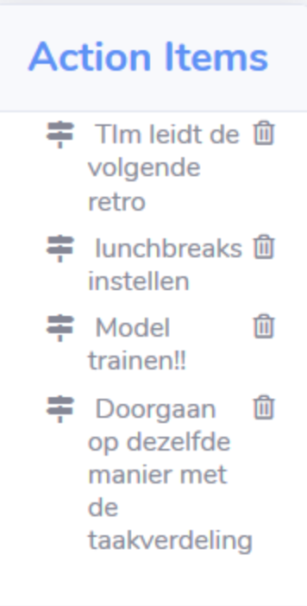
What did we do?
Scaled the data
Shifted the datapoints so that the sensor on the sternum is on the 0,0,0 point in the 3D space
Scaled the data for each person based on the length of the upper arm
Researched the OR-ensemble
Did a retrospective
Made our first model

Slide 5
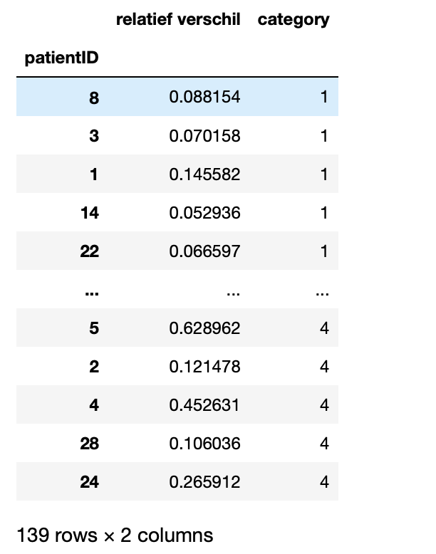
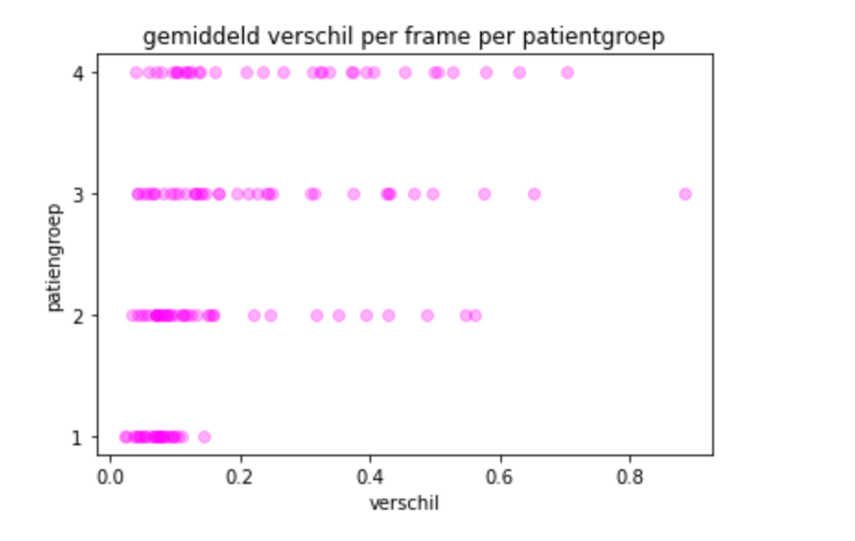
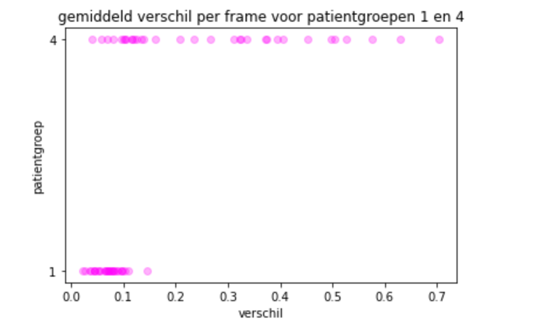
Symmetry
Researched the symmetry in movement between the left en right elbow
Sum of the absolute difference in height between the left and right elbow divided by the number of frames
Fit a logistic regression model
We used stratified Kfold. This gave us a score of 80%
It is possible to compare the other groups as well.

Slide 6
What will we do next?
Further research features
Moment of rotation of the shoulder blade
Look at the possibilities of cleaning the data
Some people did not execute the exercise right

Slide 7
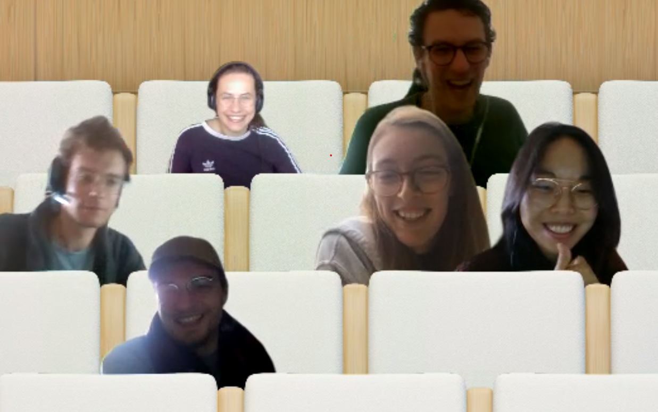
Questions?

